Slide 1
ORTHORAPID
24/7 EMERGENCY ORTHOPAEDIC RESPONSE
Mr Rishi Chana FRCS Ortho
Consultant Orthopaedic Surgeon
07713445694
36 hours from telemedicine consultation to completion of investigations with diagnosis and treatment agreed
MSK GP Pathways Guidance

Slide 2
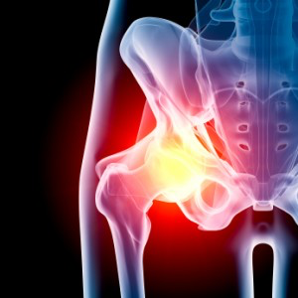

Slide 3
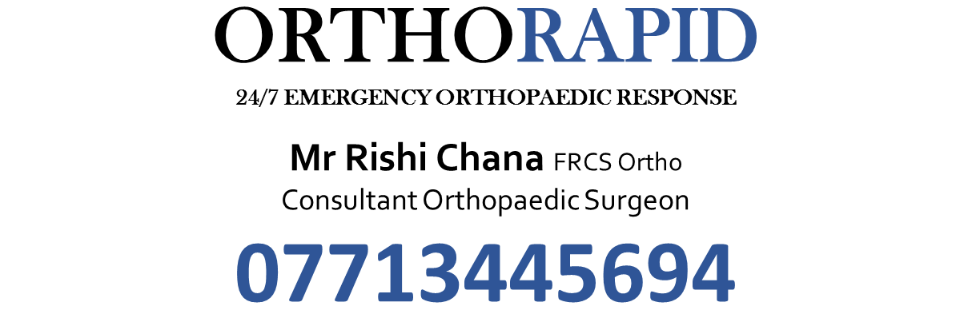
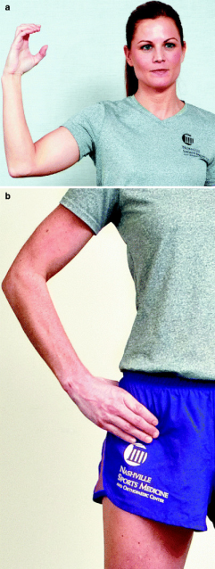

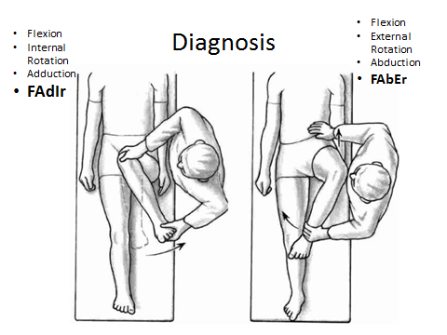
Red Flags / Same Day referral
Call Emergency Orthopaedic Consultant
Inability to weight bear
New symptoms in previous joint replacement
Inability to lift leg after trauma ?Stress fracture
Systemic symptoms
Previous malignancy and new onset hip pain
Painful clicking after injury
Arthritic Hip Pathway
Sports injury / Acute Non-Arthritic Hip Pathway
Worsening dull toothache pain in groin & buttock limiting lifestyle and quality of life
>45 years old
Activity related joint pain (groin, inner thigh or deep buttock)
< 30 minutes or NO early morning stiffness
Acute Injury
Non-traumatic Hip Pain with Mechanical symptoms
Sudden onset hip/groin/buttock pain during exercise
Positive C-sign pain
Impingement test +ve in FAdIR / FAbER
Clicking with hip
Snapping hip
Feeling of joint dislocation or instability
Pain interfering with usual activity regime
Cannot cope with hip rotation extremes
Young to middle aged active adults
Greater Trochanteric/Buttock pain
Dull ache worse on activity and after period of rest
Pain getting in/out car, crossing legs over, socks & shoes.
Clicking, locking or catching with the hip
Unable to keep up with hobbies / sports
Conservative measure steps
Advice, activity modification, lifestyle change, weight loss (↓by 5% can equal up to 50% less pain).
Surrey iMSK website for self-management advice.
Physiotherapy
OTC analgesia (paracetamol, Ibuprofen)
Prescribed medication (Naproxen, volterol, Codeine)
Refer to Hip Specialist for consideration of:
Ultrasound guided joint injection (if not available in primary care) or Total Hip Replacement Surgery
Call Emergency Ortho
Consultant
Refer to Hip Specialist
Notes:
NICE Guideline IPG 408 Hip Arthroscopy
www.nice.org.uk/guidance/IPG408/publicinfo
Hip OA
Osteoarthritis: Care and management in adults (NICE clinical guideline 177

Slide 4
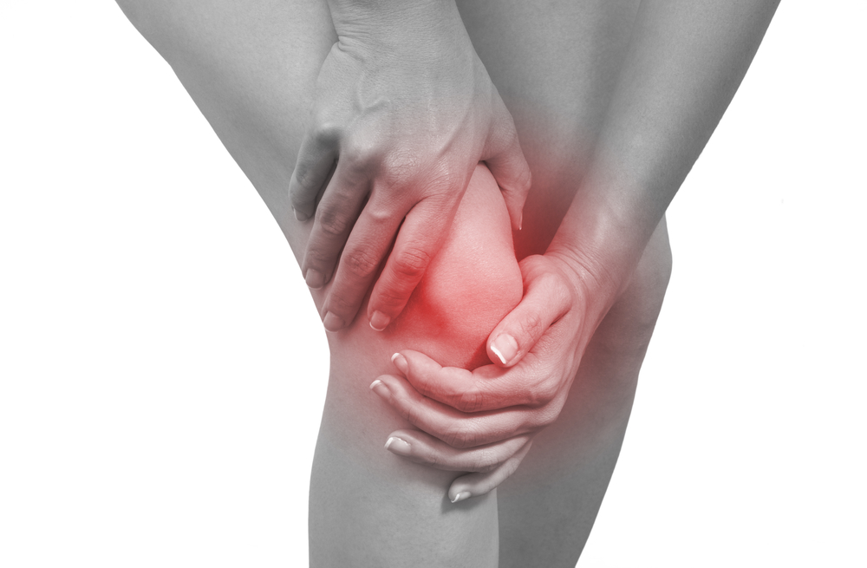

Slide 5
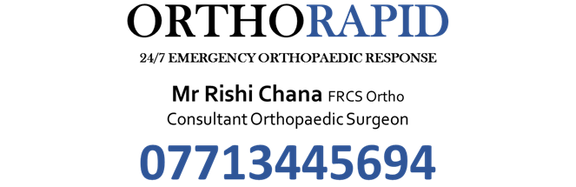

Slide 6
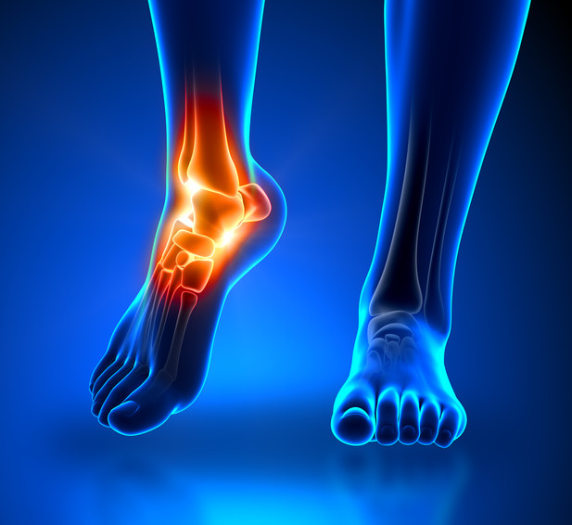

Slide 8
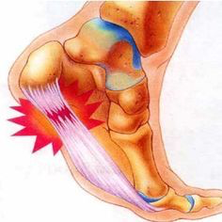

Slide 9


