Slide 1
Indications for a Partial Knee Replacement
Patient Expectations
Outcomes
Mr Rishi Chana FRCS Orthopaedic Knee Surgeon

Slide 2
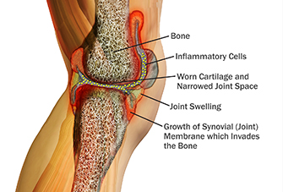
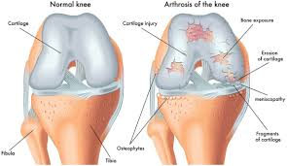
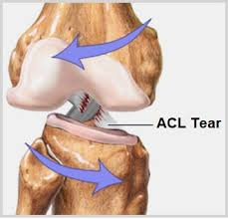
Type of Arthritis wear
Osteo arthritis = wear & tear OA 70%
Post injury = ACL and ligament injuries 15%
Inflammation = Rheumatoid or Gout type of conditions 15%

Slide 3
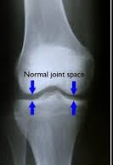
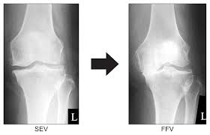
Wear Patterns: Inner or Outer Isolated Arthritis

Slide 4
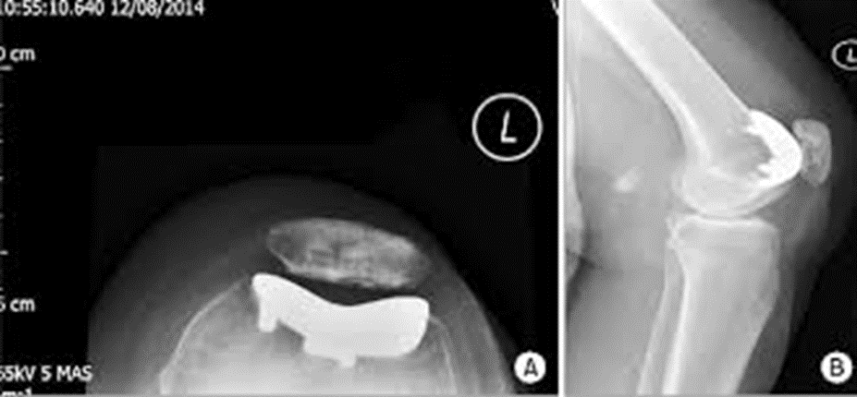
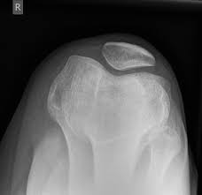
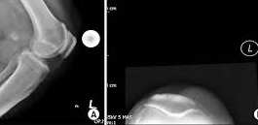
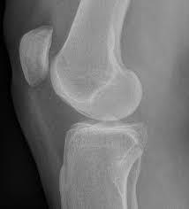
Wear Patterns: Knee cap isolated wear

Slide 5
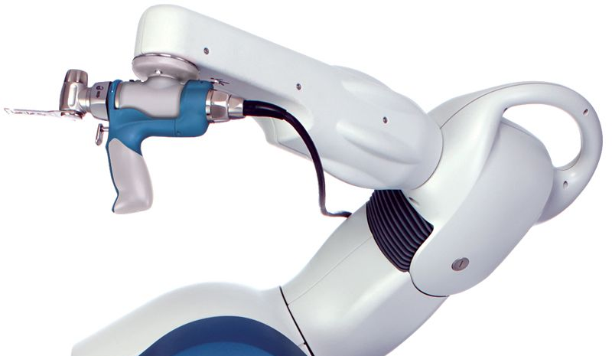
MAKO – Robotic Assisted Joint Surgery
Mr Rishi Chana
FRCS Tr&Orth
Certified MAKO
Hip & Knee Surgeon
0203 494 4034
Princess Margaret
Hospital
www.rishichana.co.uk

Slide 6
What is all the fuss about?
History of Joint replacement techniques and evidence based landmark improvements.
Reliable reproducible results every time.
Paradigm shift from Analogue to Digital era.
Less invasive surgery = Better physiological reaction = Enhanced Recovery

Slide 7
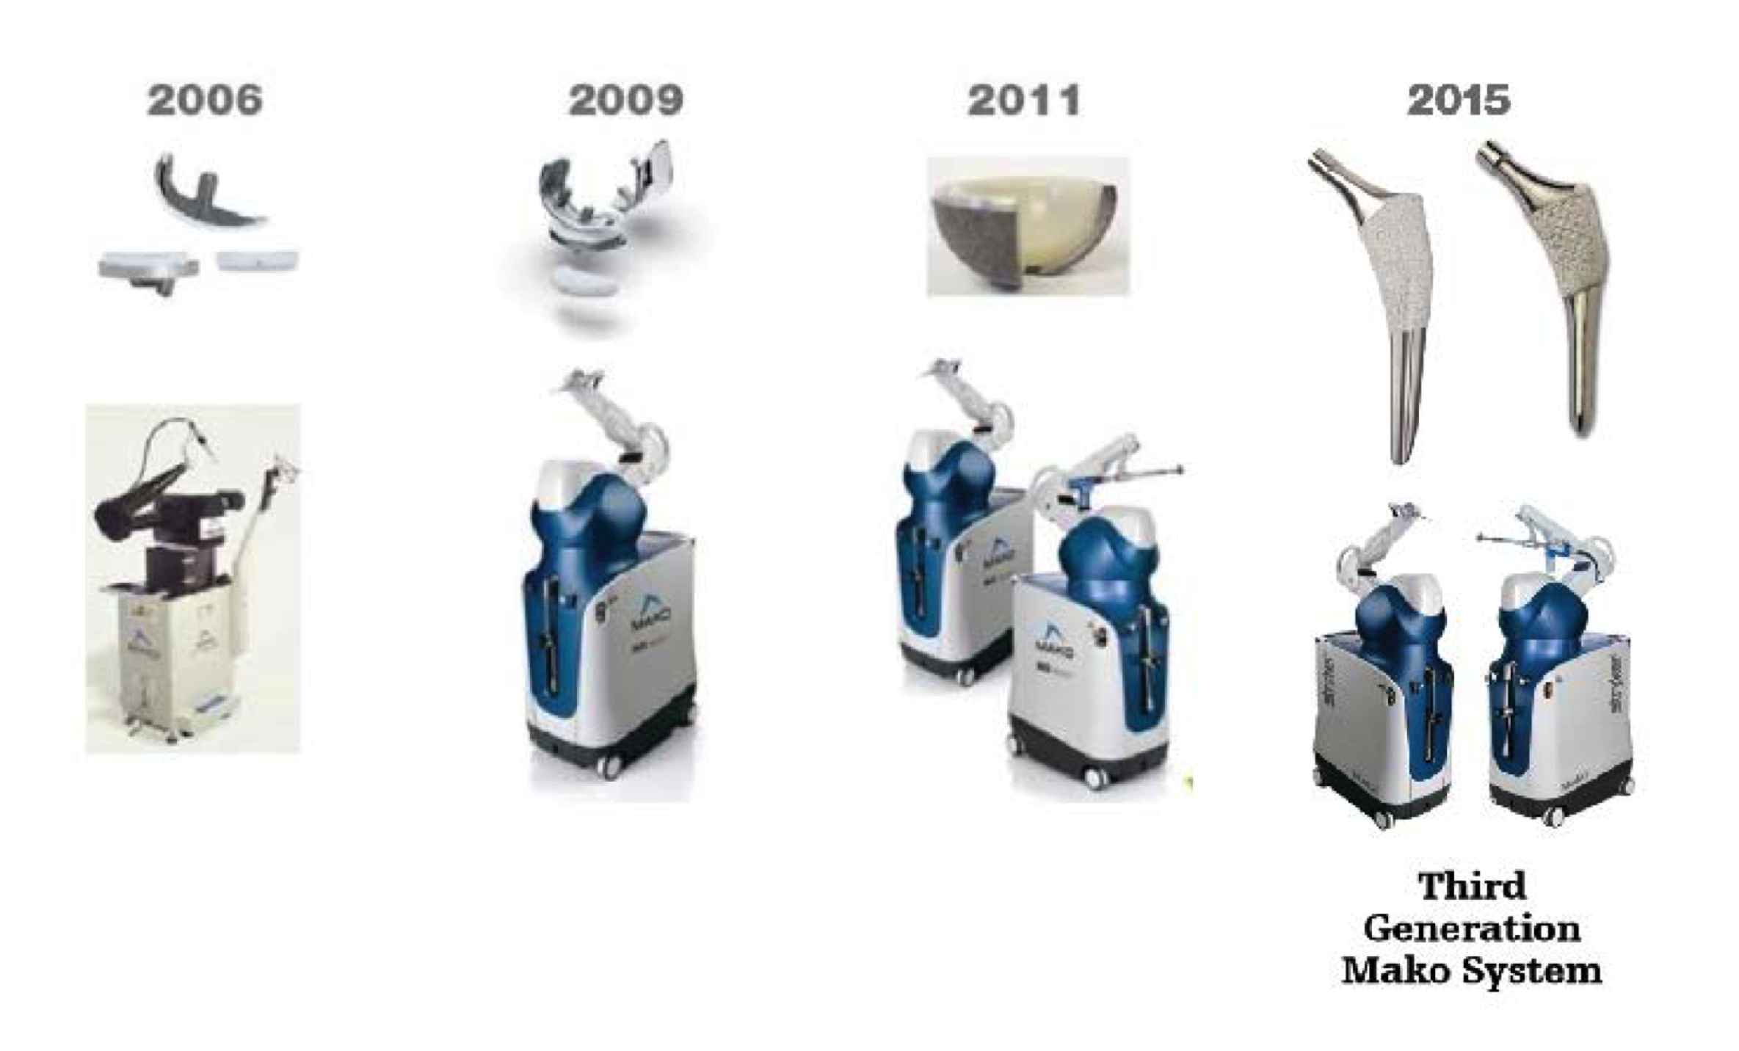
Evolution of Joint Replacement Tech:

Slide 8
Patient Journey
Seen in clinic, history and examination, xray to confirm diagnosis
Informed consent shared agreement, after failed conservative treatments…
CT to marry up the Real Patient and Virtual Computer Navigated Model (Robot)
Pre-op Planning
Surgery
Rehab

Slide 9
Mako Total Knee Replacement

Slide 10
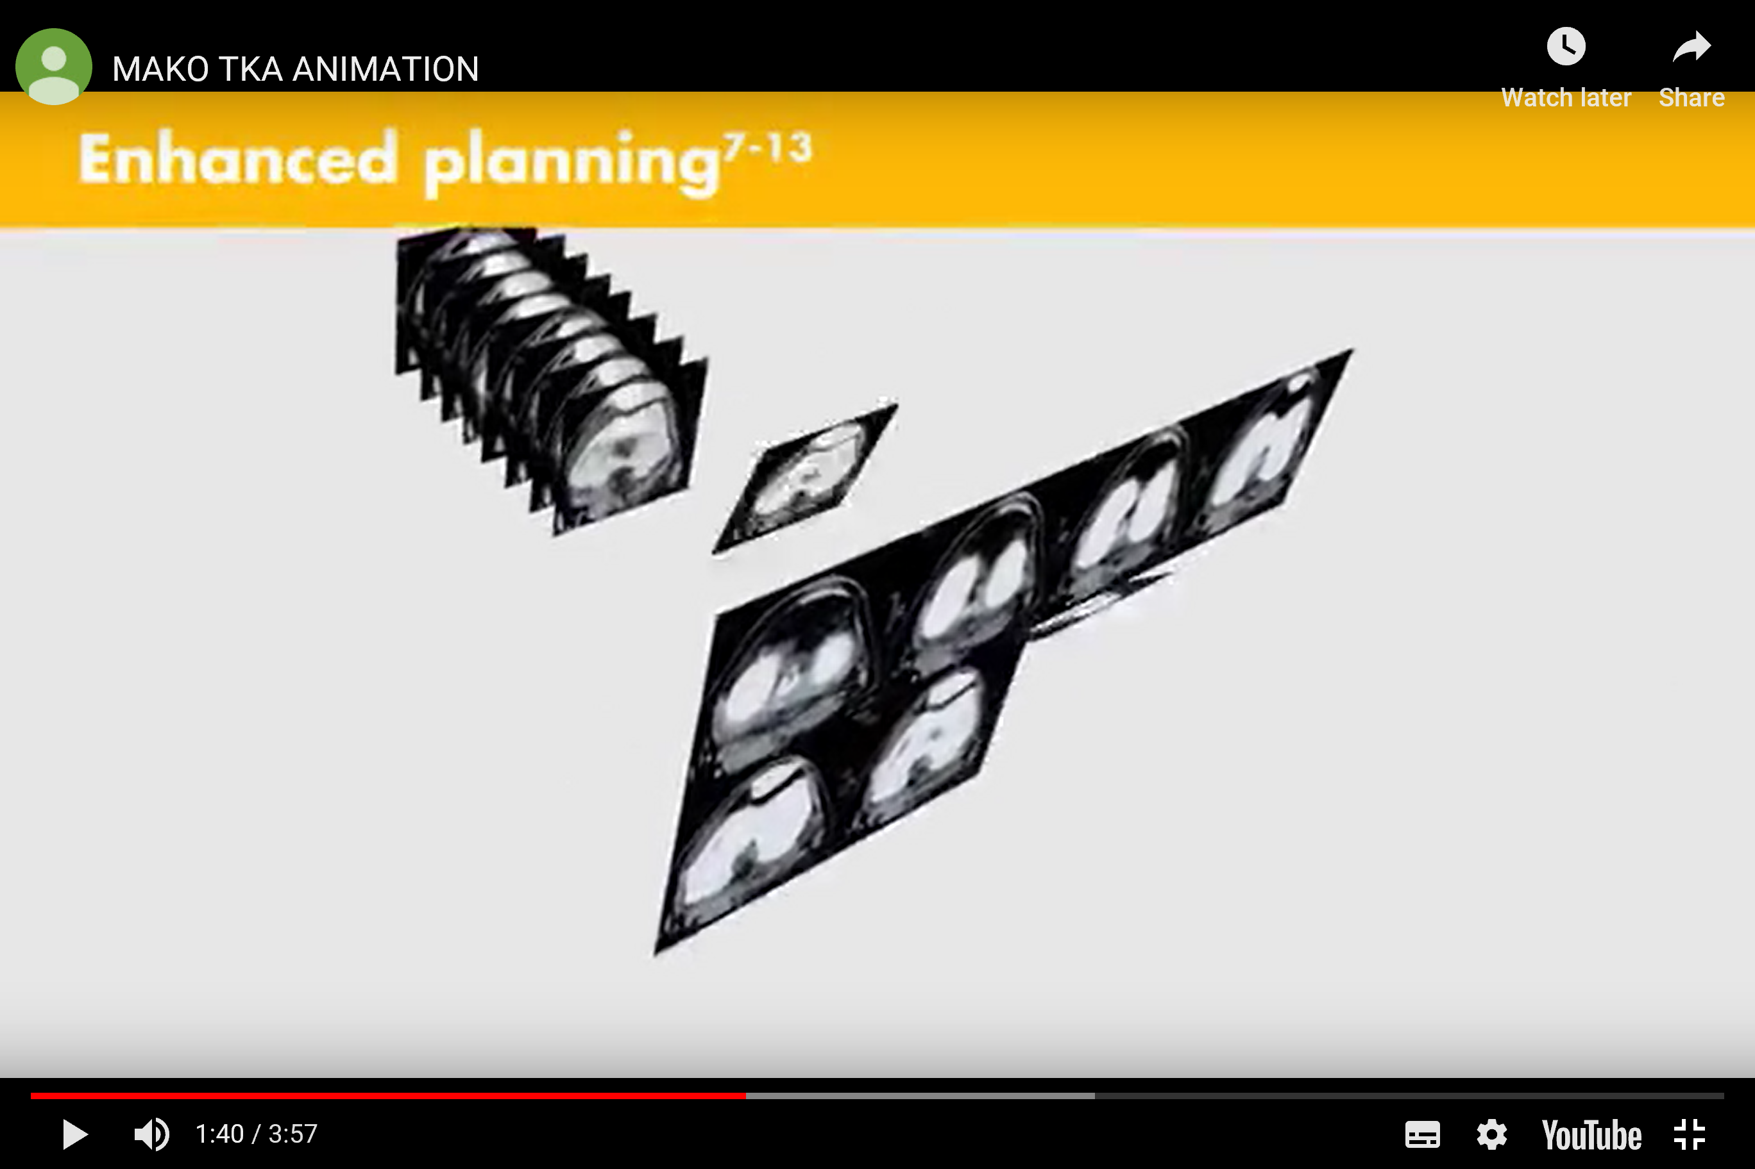

Slide 11
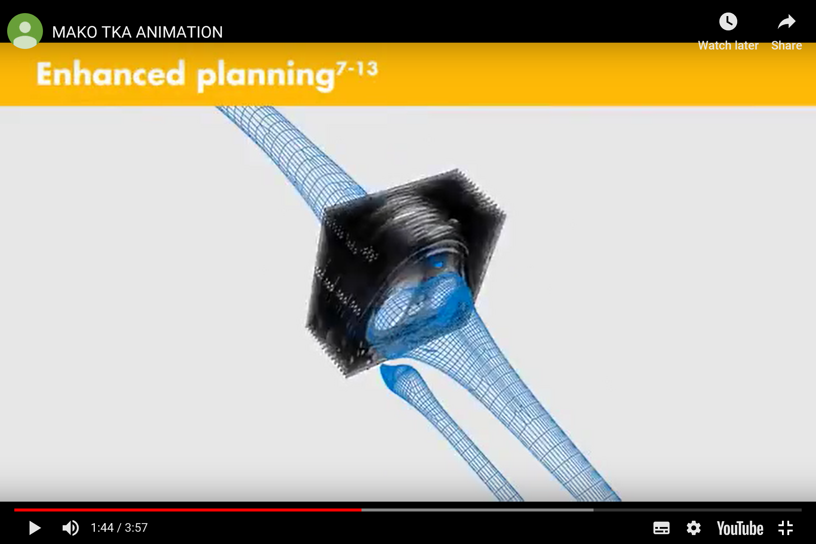

Slide 12
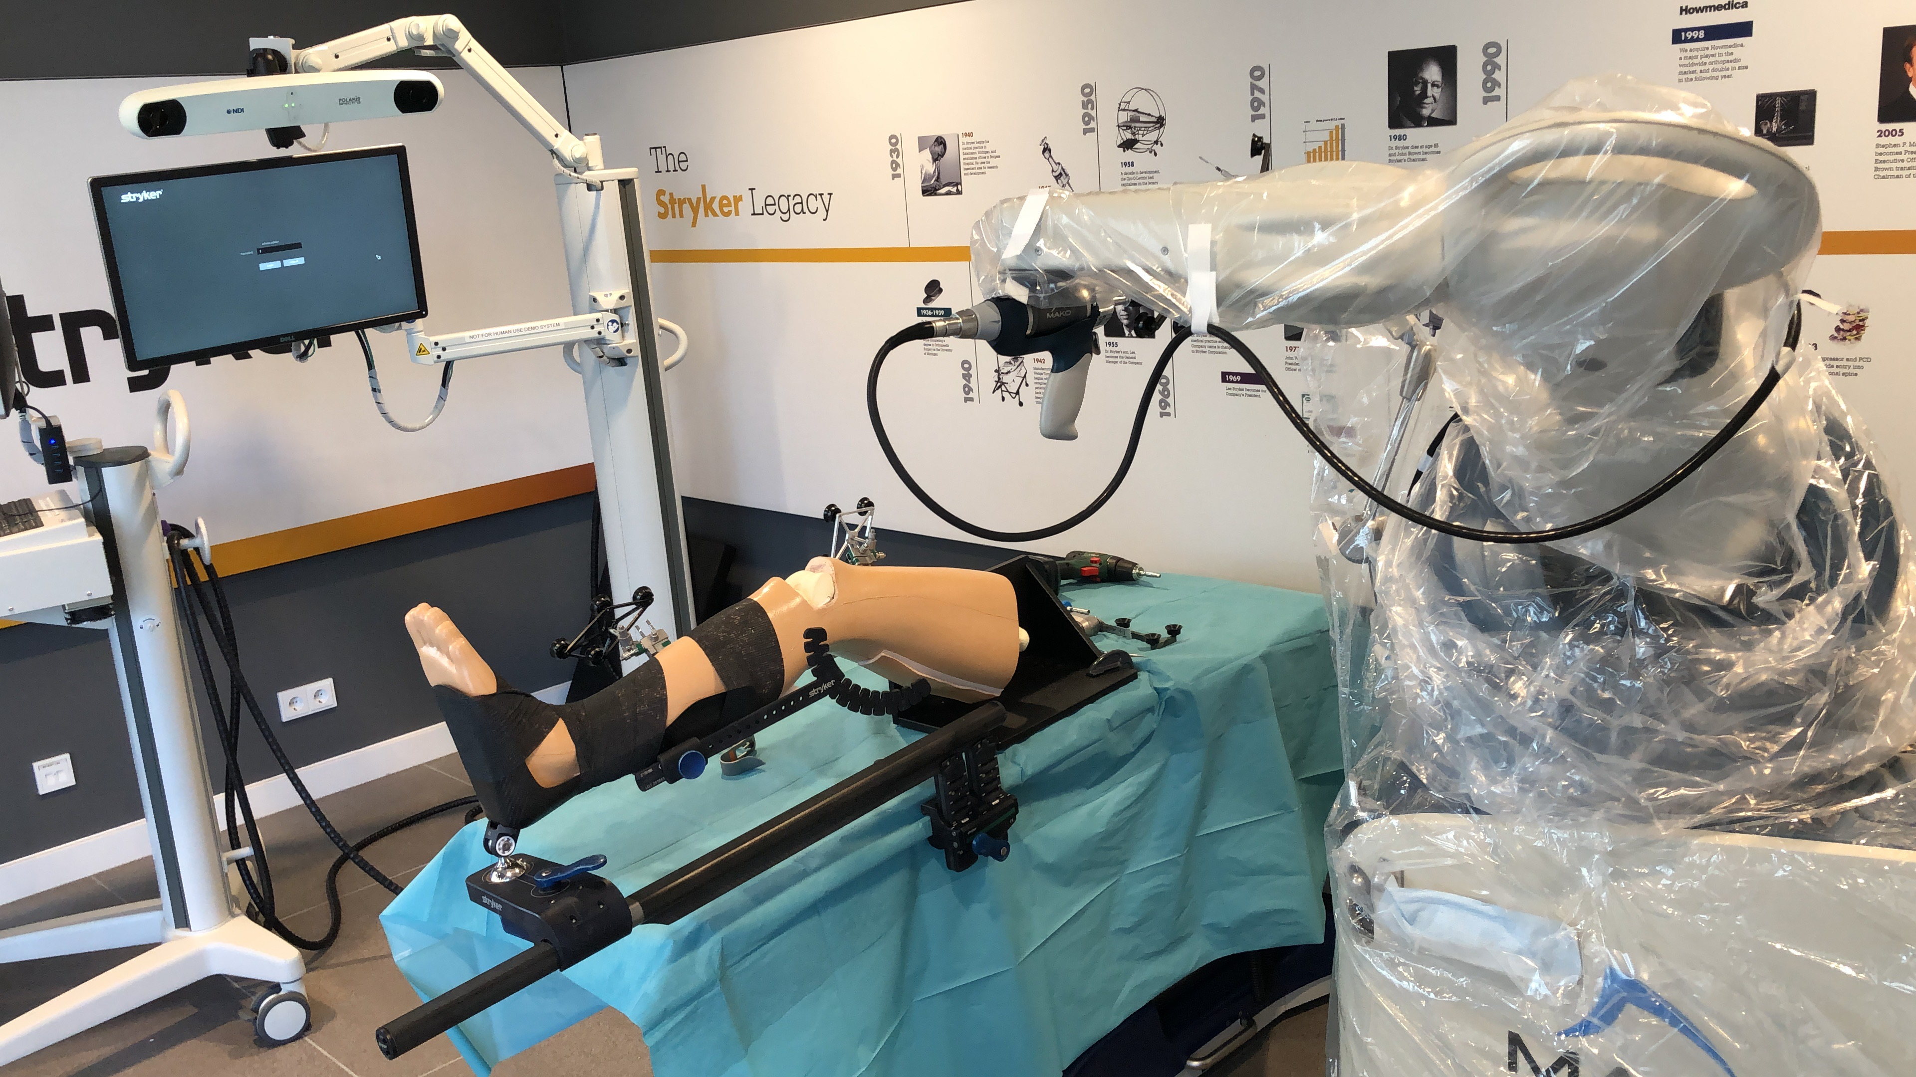

Slide 13
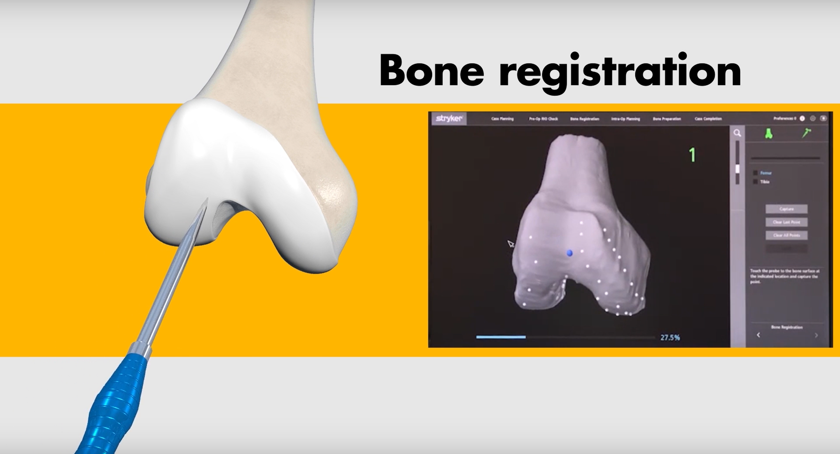

Slide 14
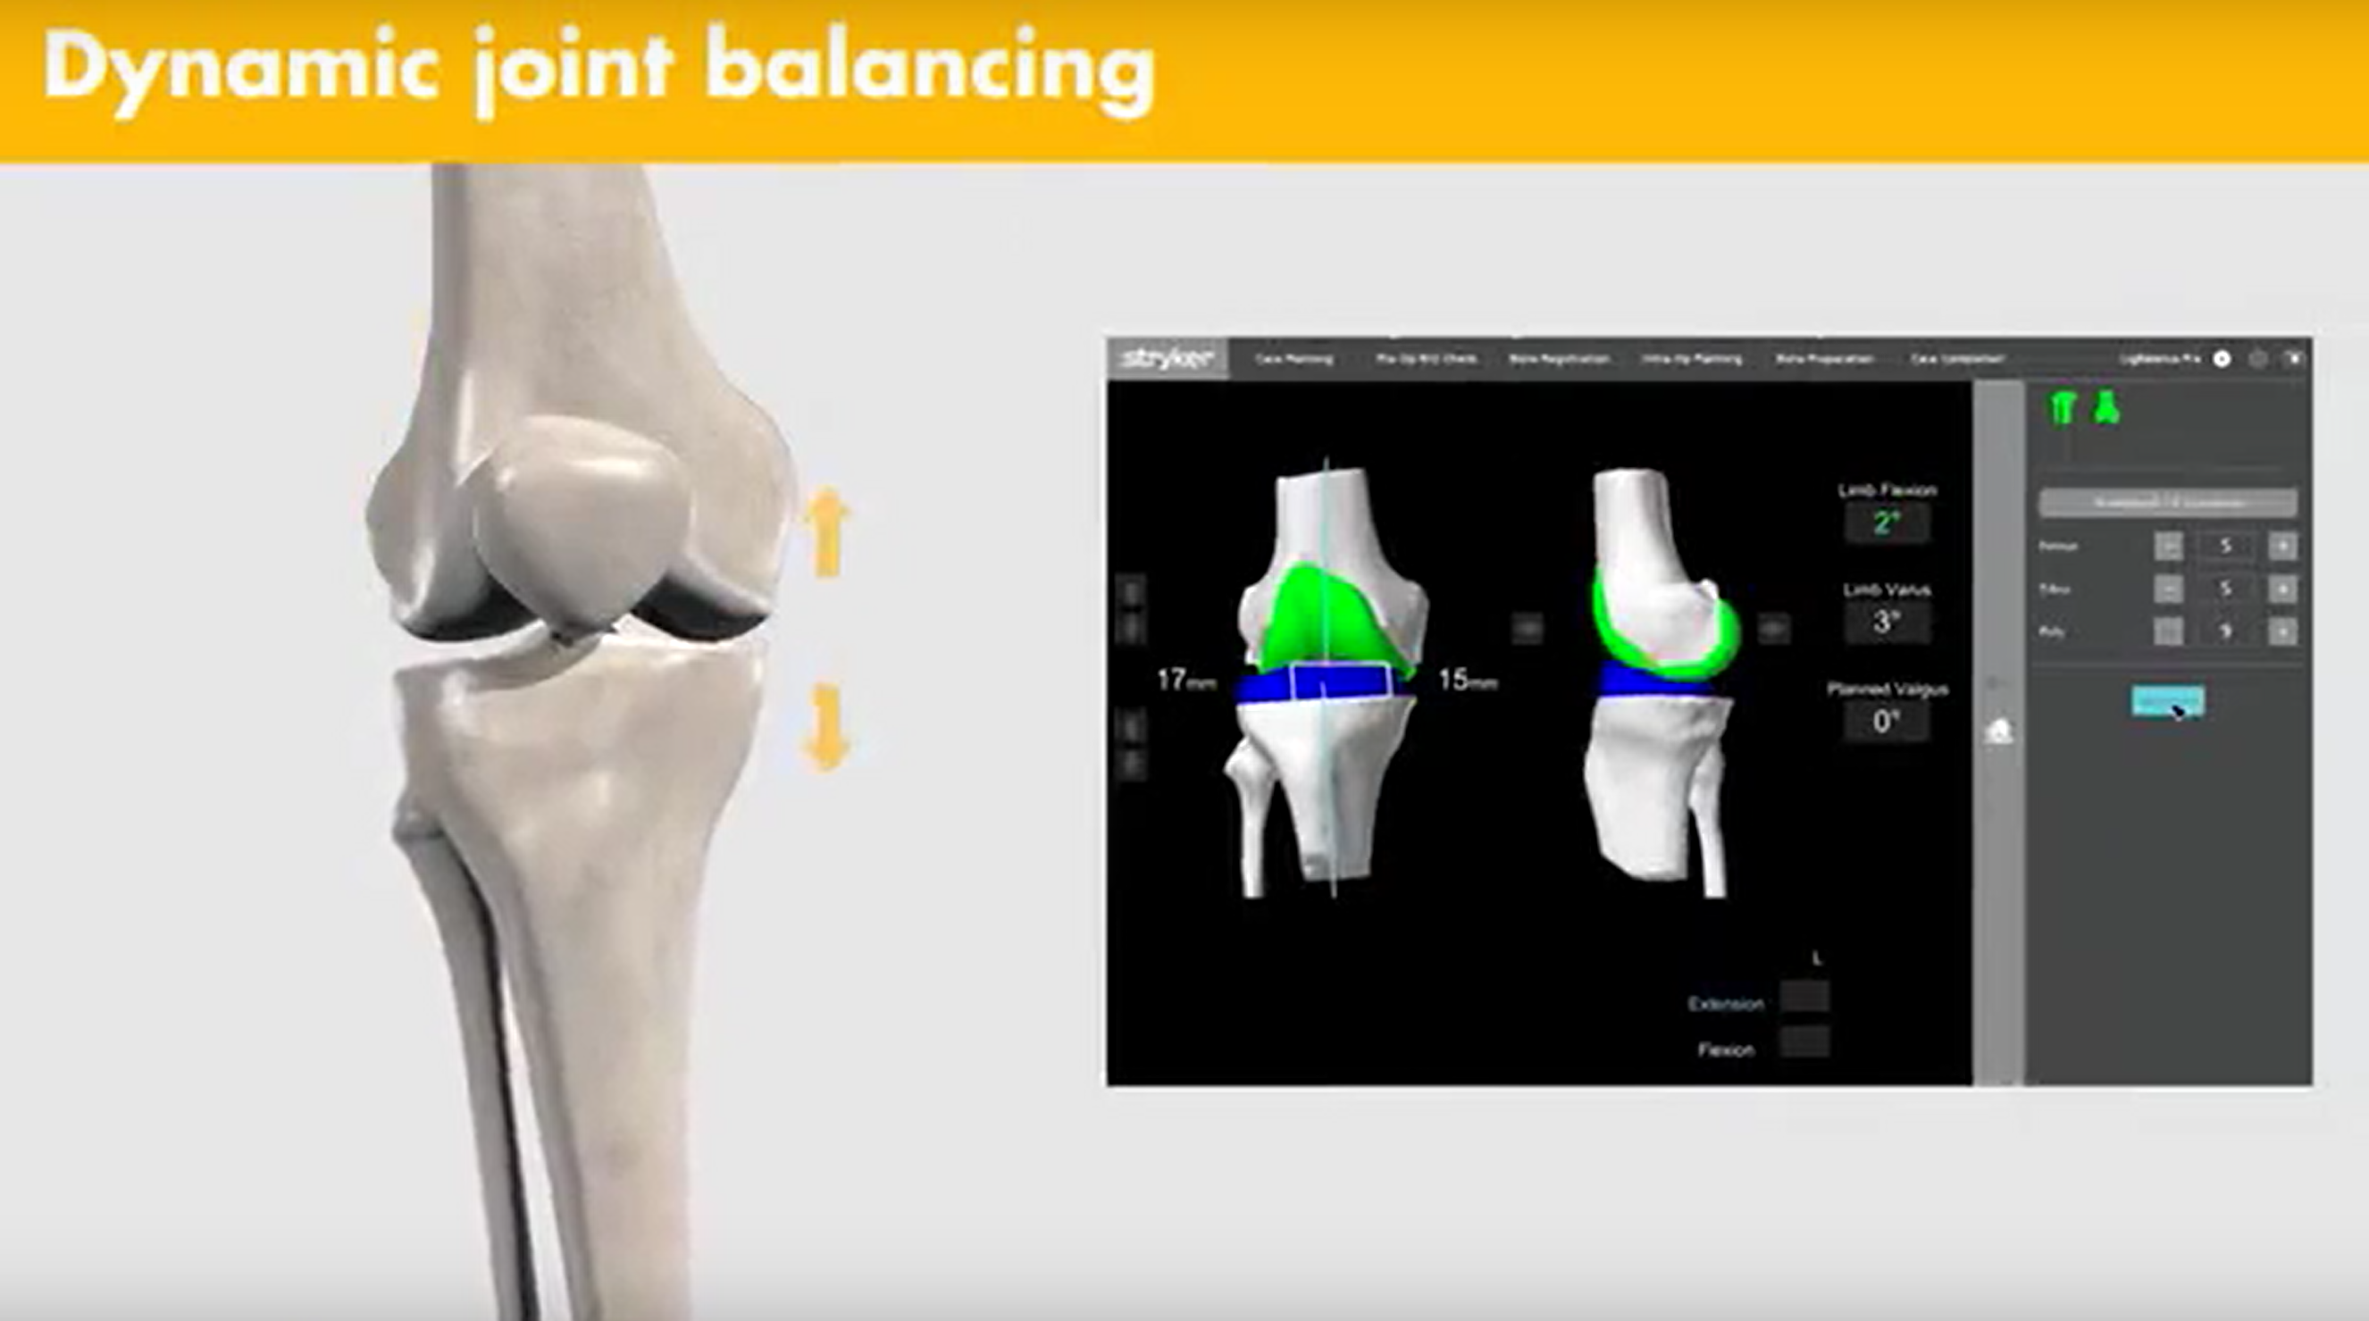

Slide 15
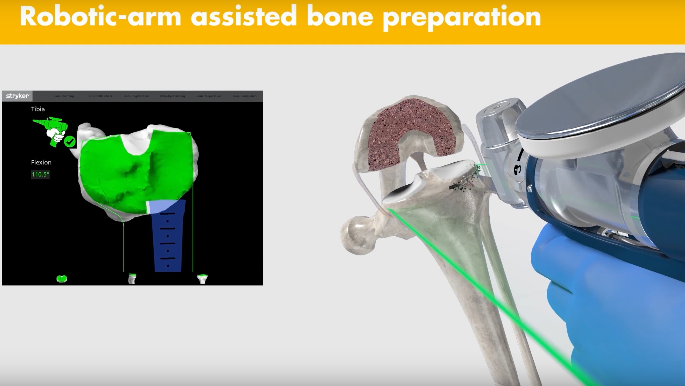

Slide 16
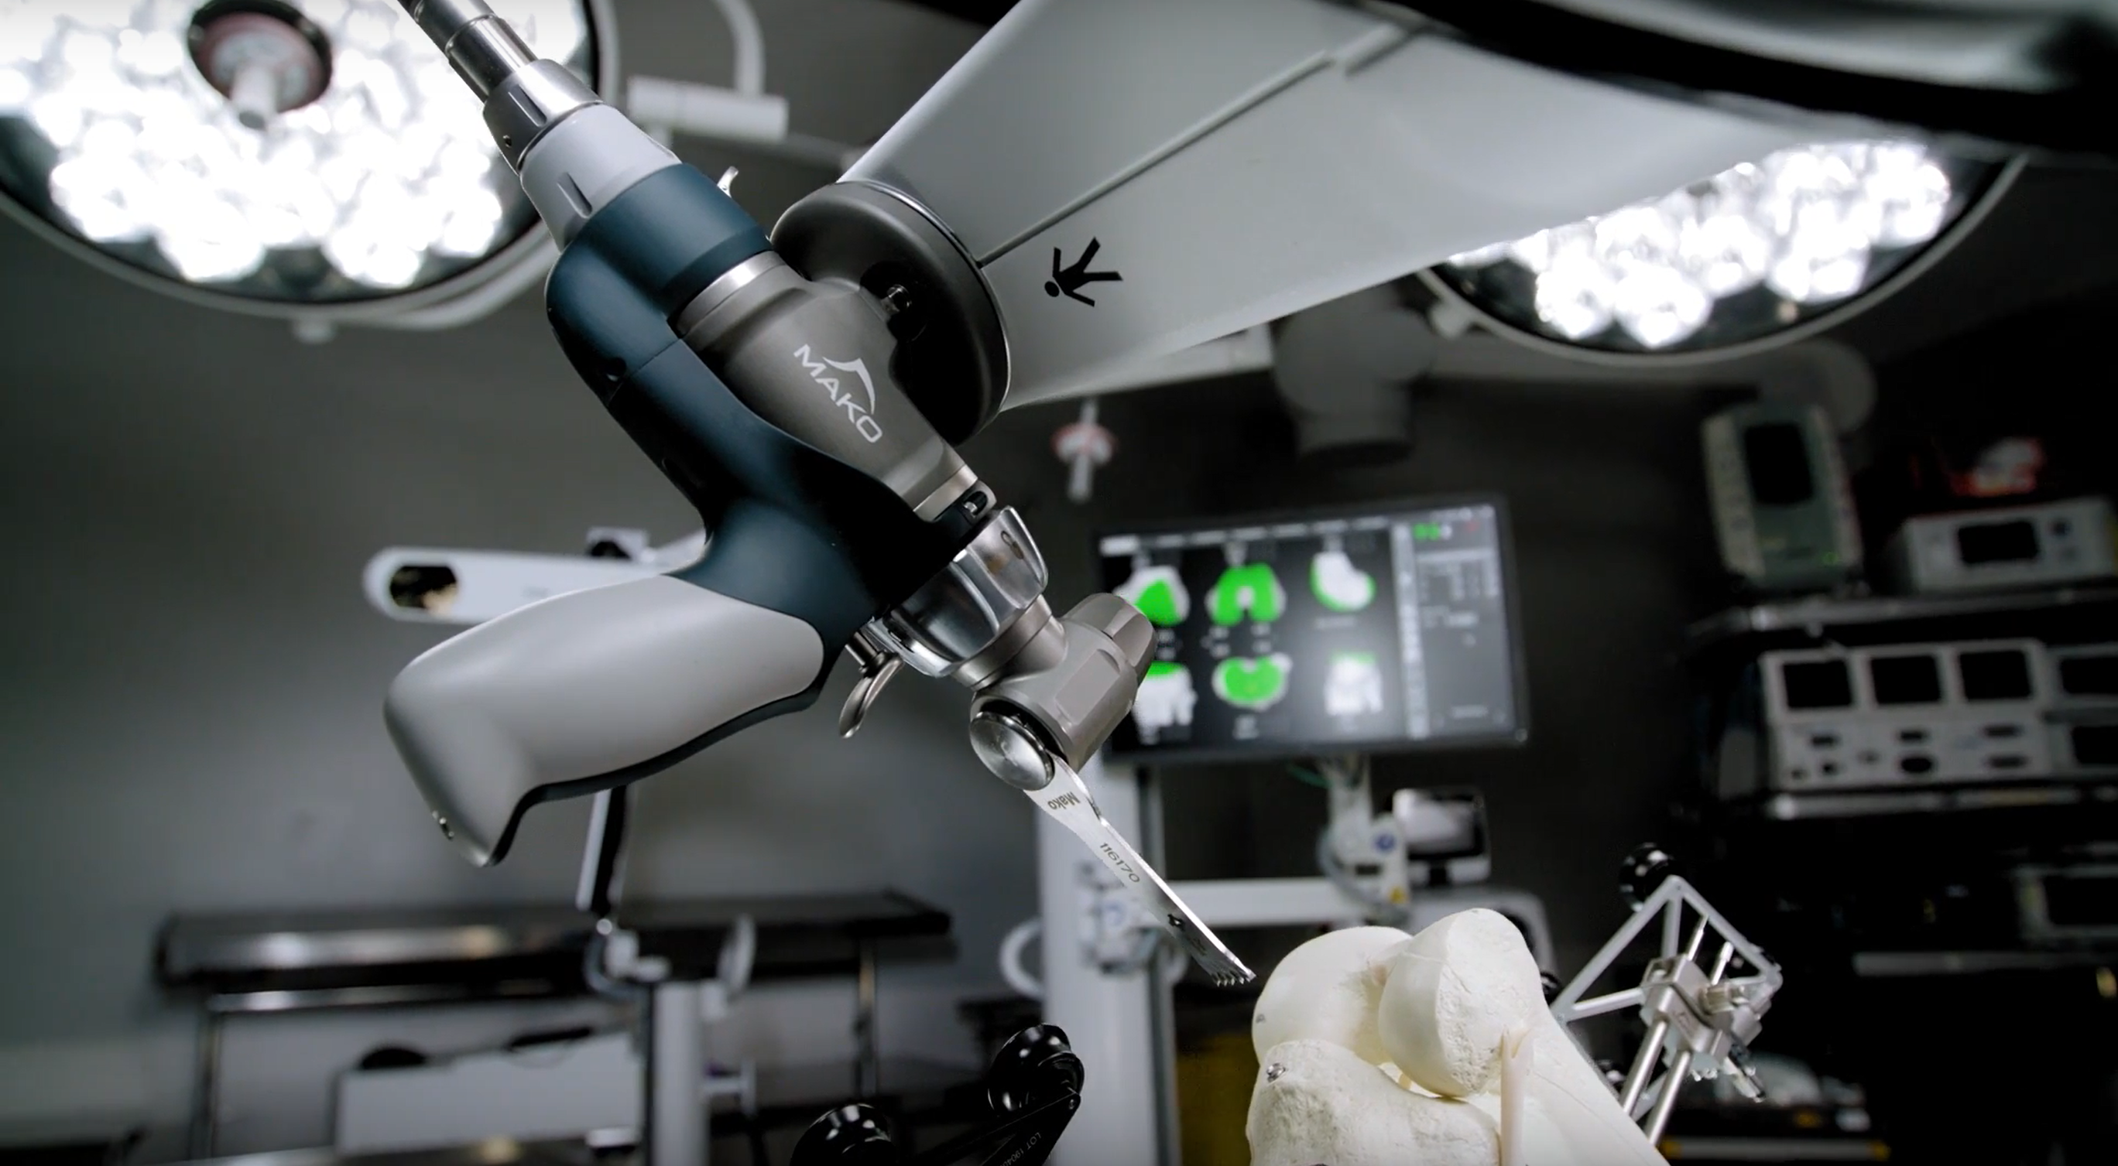

Slide 17
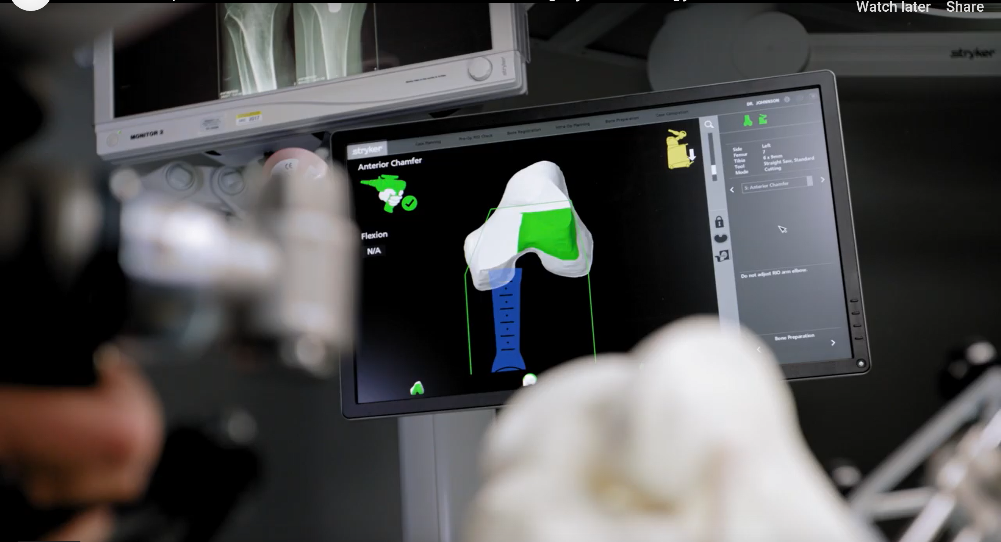

Slide 18
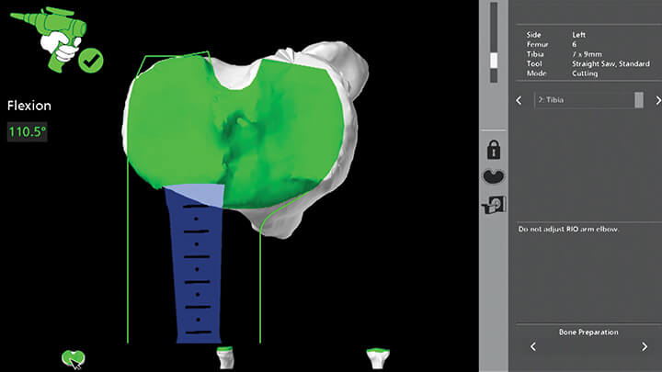

Slide 19
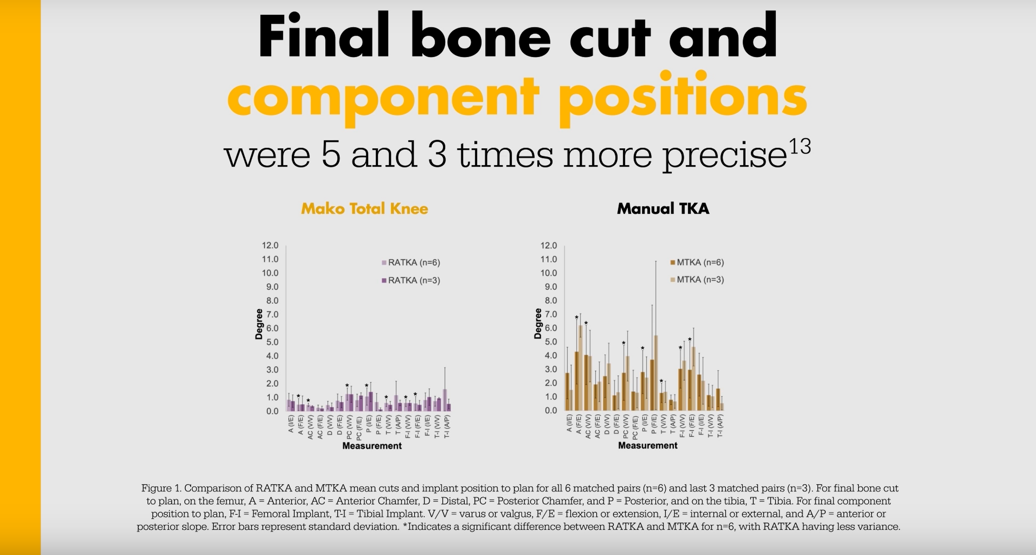

Slide 20
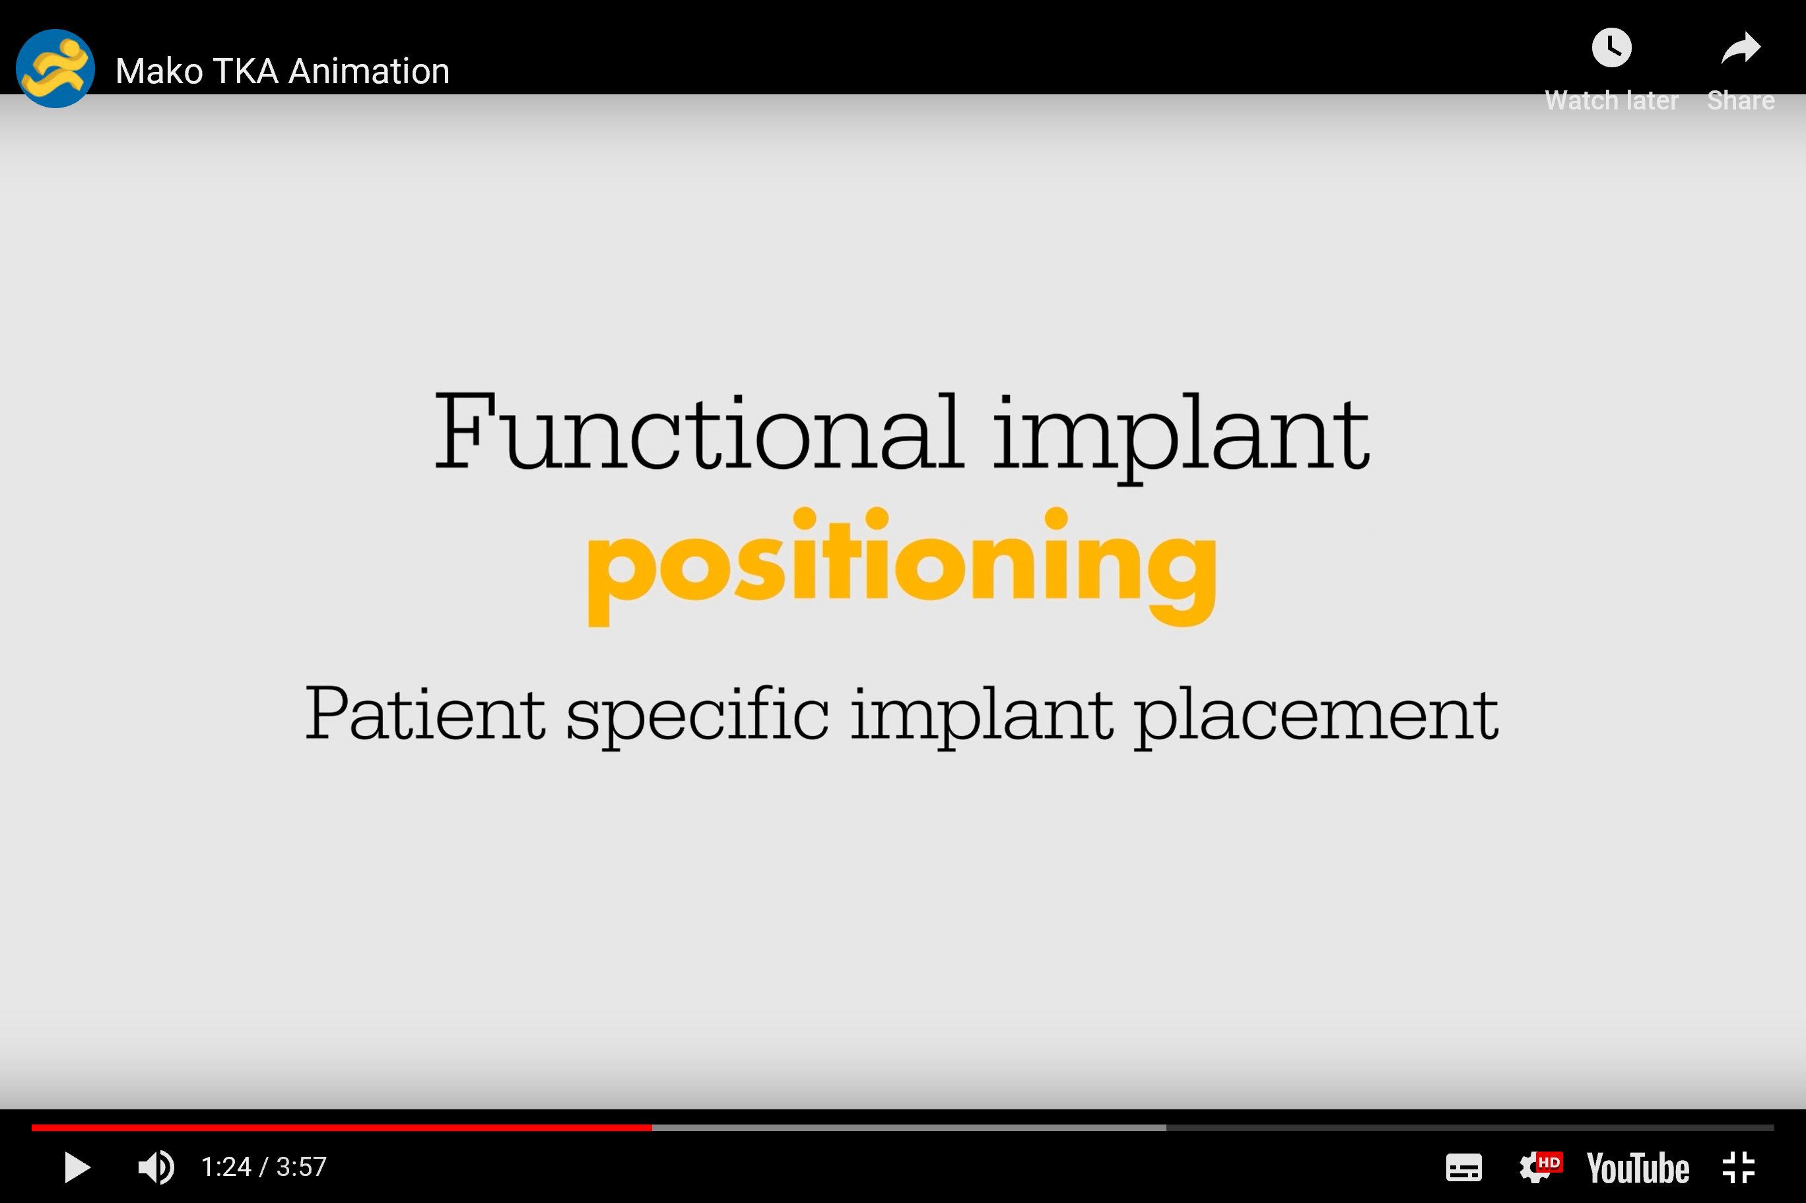

Slide 21
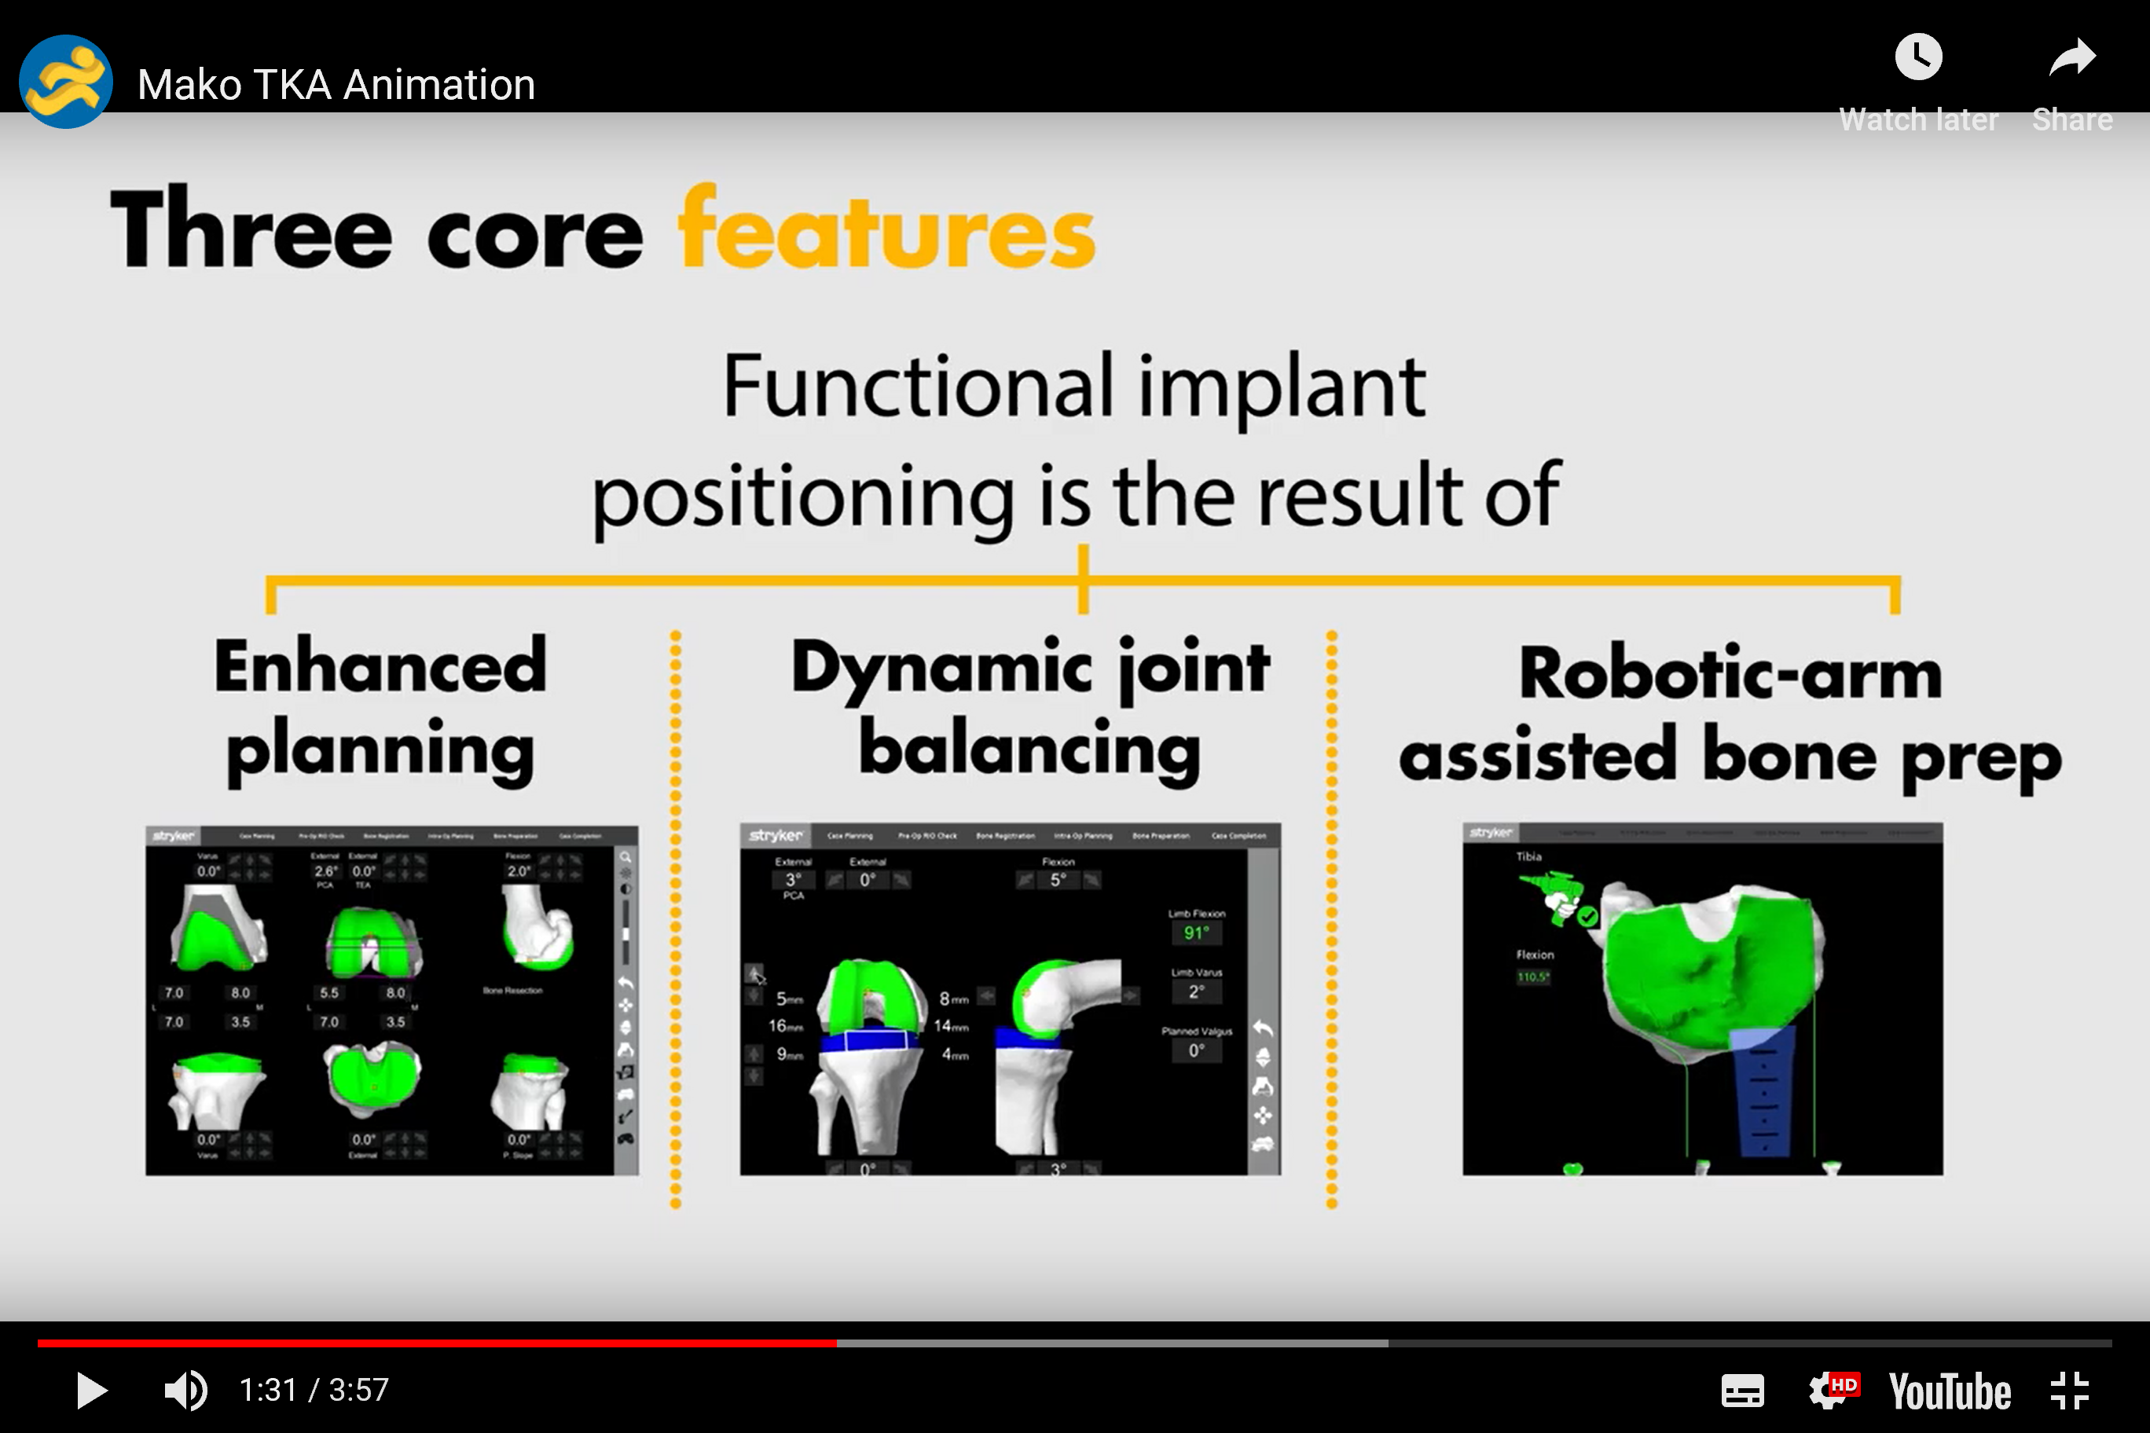

Slide 22
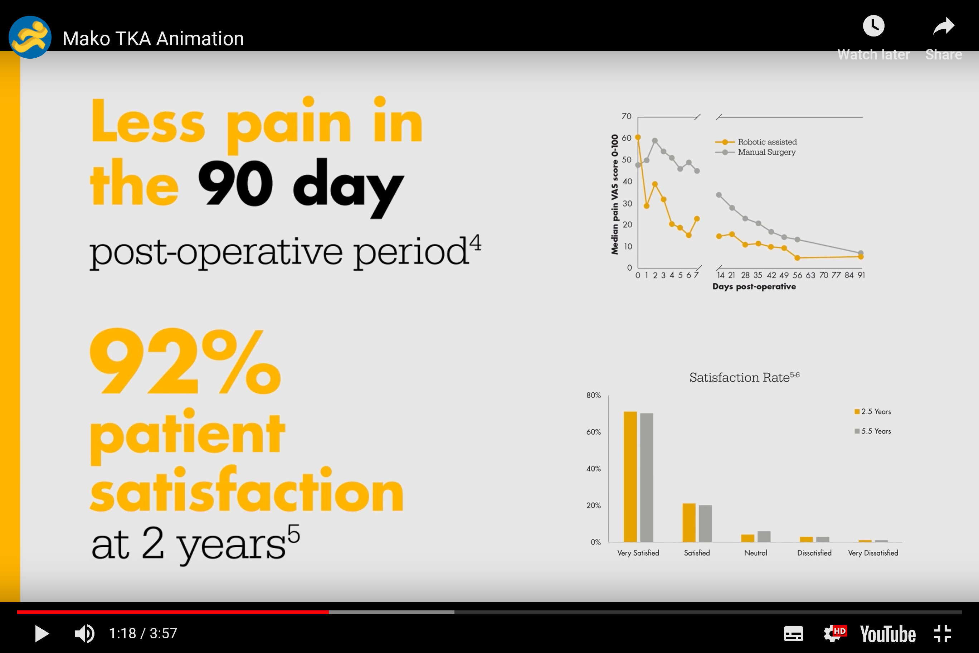

Slide 24
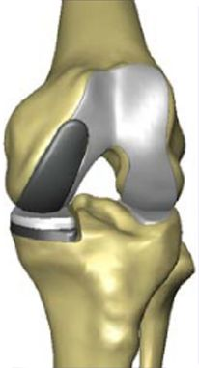
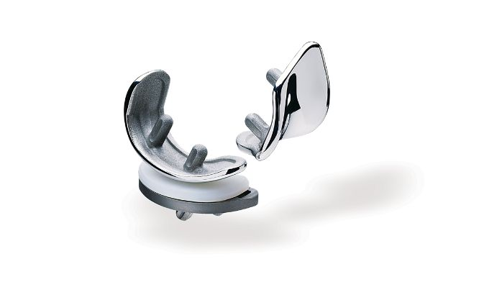

Slide 25
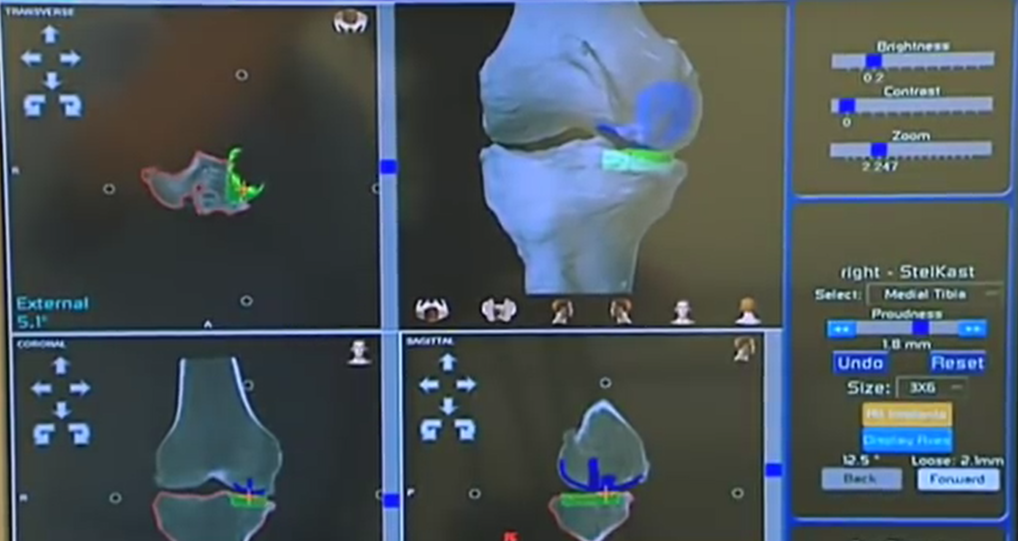

Slide 26
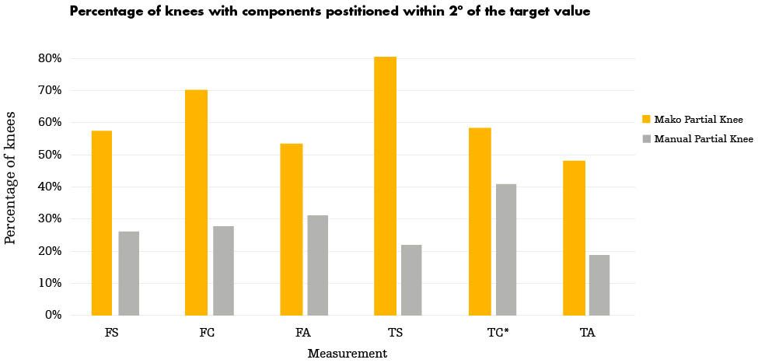

Slide 27
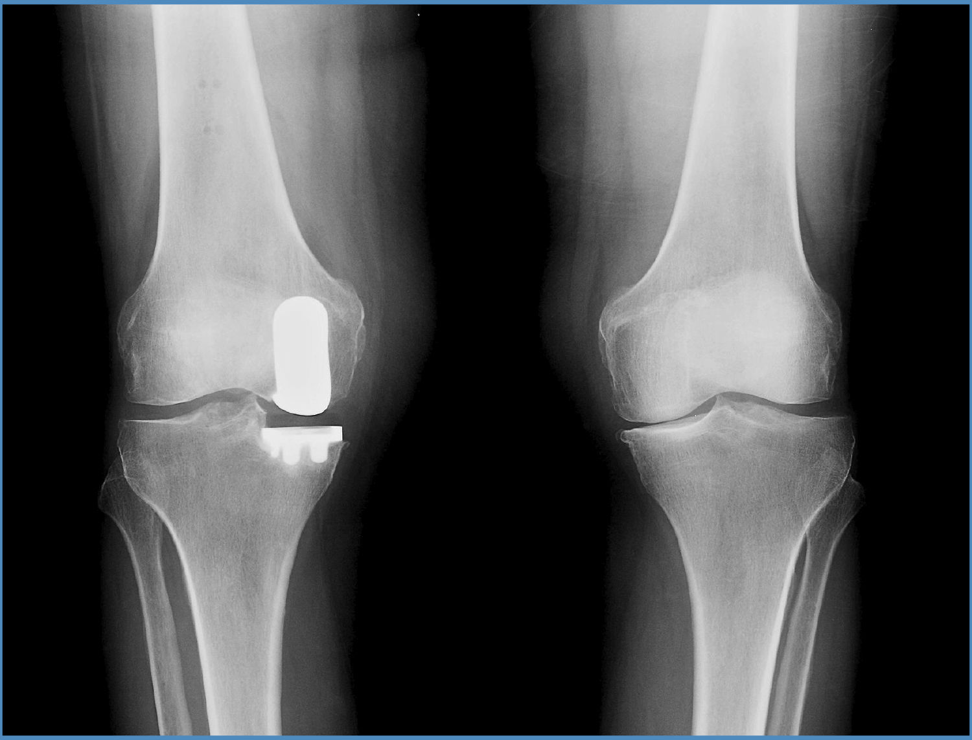

Slide 28
Survivorship 1 year and 5 years

Slide 29
Insert video here please

Slide 30
MAKO Partial Knee Replacement
Develop your own individual customised personal plan like never before.
Millimetre and single degree accuracy.
Almost guaranteed results?
See your post-op xray in the clinic before even starting surgery!

Slide 31
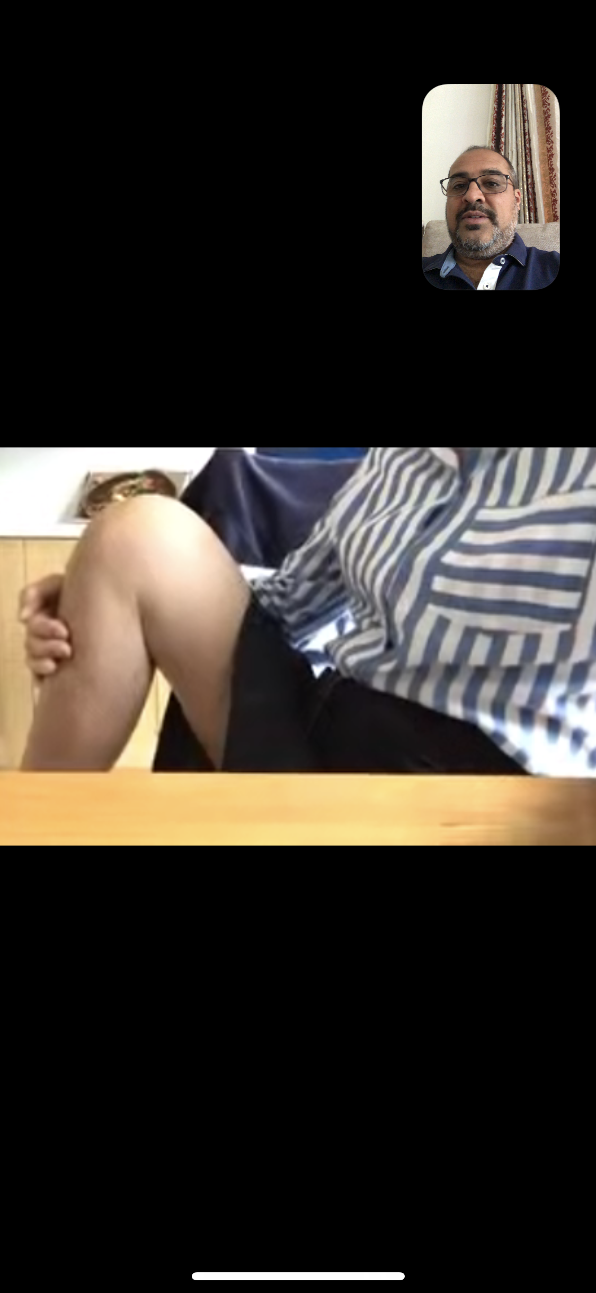
Knee flexed at 6 weeks…

Slide 32
Thank you
Any questions?

Slide 33
Pmh video here please

Slide 34





@londonhipsurgeon
www.rishichana.co.uk
Mr Rishi Chana
Rishi Chana
Rishi Chana London Orthopaedic Hip & Knee Surgeon 02034944034
Rishi Chana 200 Five star reviews
Certificate of Excellence 2017-19

